Slide 1


COMPANY PRESENTATION

Slide 2
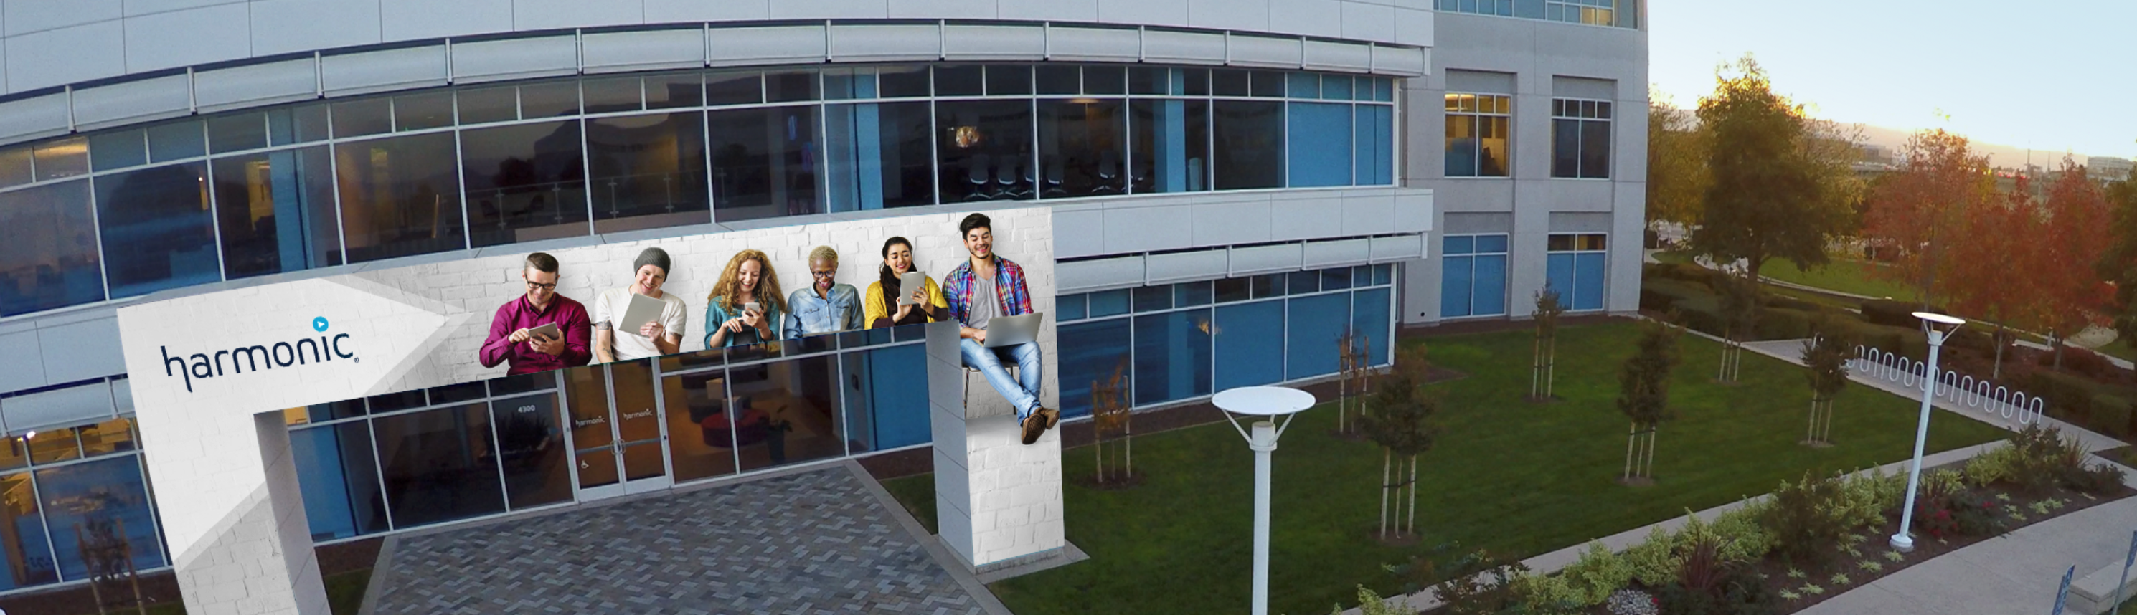
Harmonic-at-a-Glance
$403M
2019 Net Revenue
Two market-leading business units:
Video & Cable Access
Silicon Valley
Headquarters
>5,000
Media & Service Provider Global Customers
$85M
R&D Spend

Slide 3






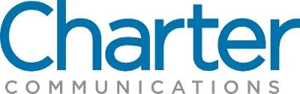

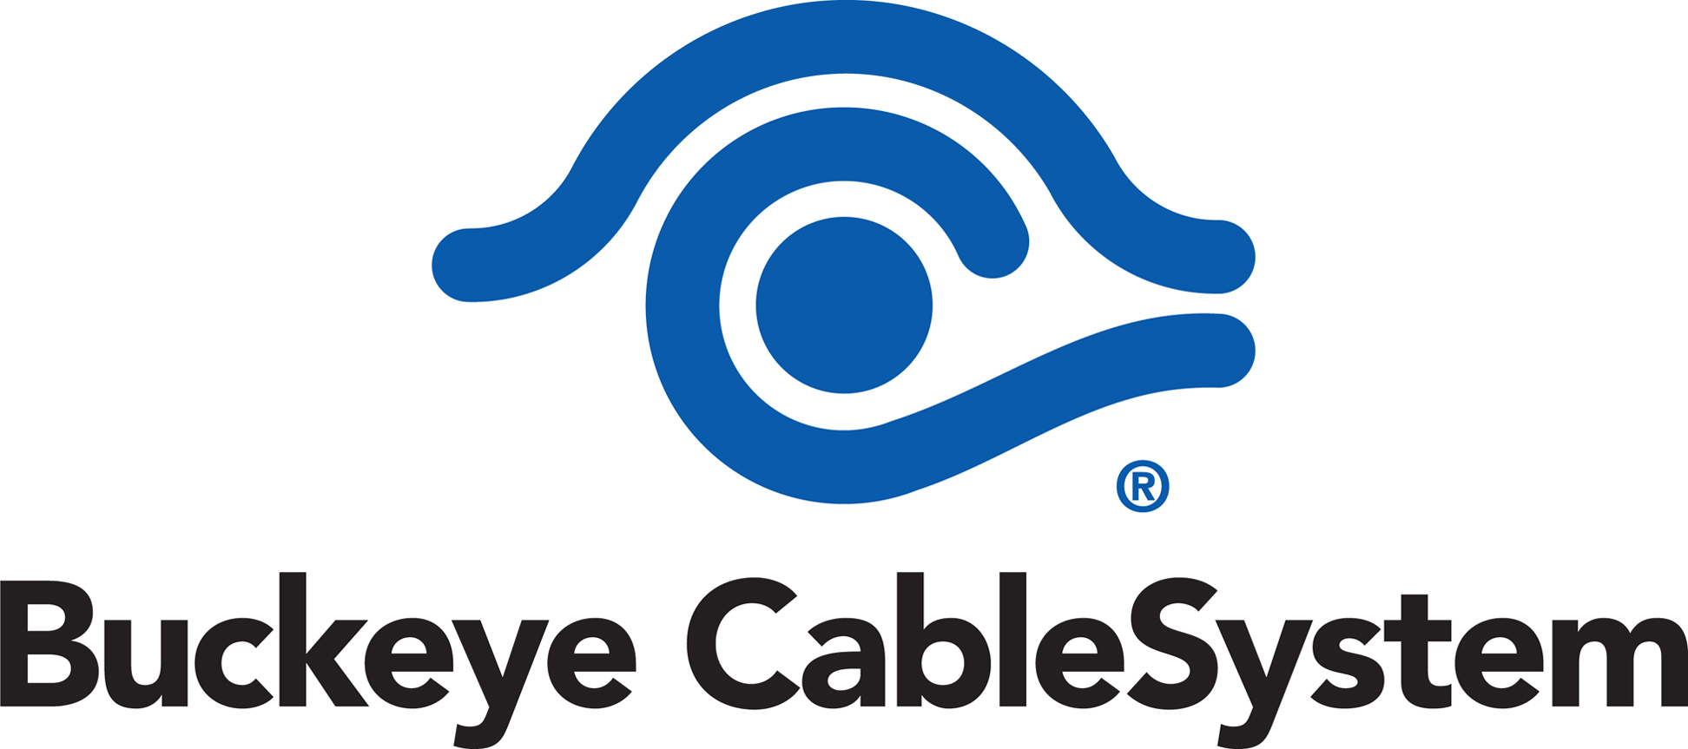

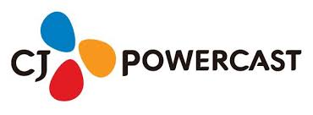


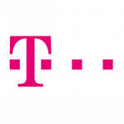


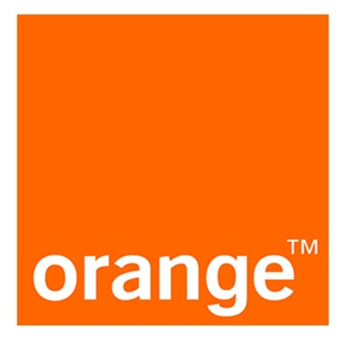

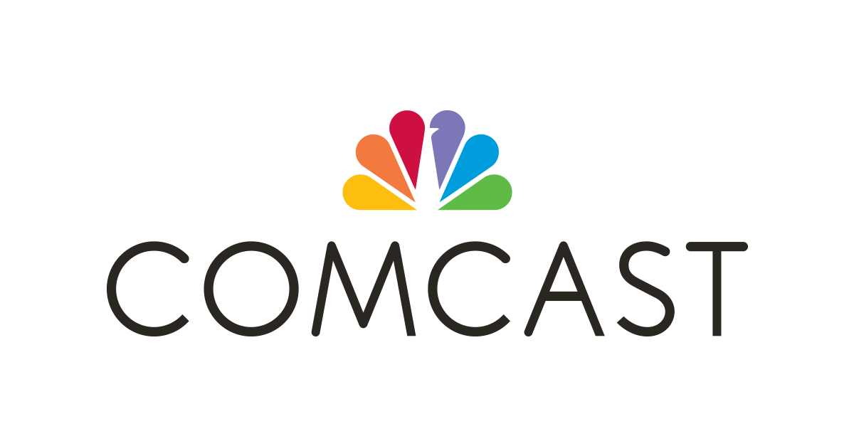


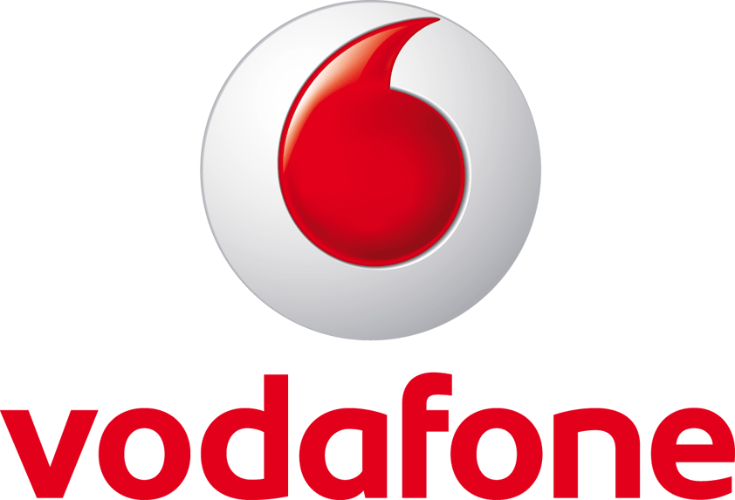

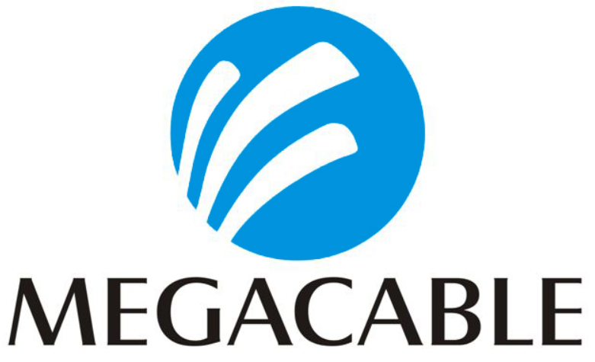







Two Market-Leading Business Segments
Video
Cable ACCESS
Mission
To provide smarter, faster and simpler video streaming solutions to the world’s leading media companies who are transforming their businesses to compete in the premium OTT video world
Mission
To provide innovative cloud-native cable access solutions to the world’s leading cable companies, enabling flexible and scalable roll out of next generation Gigabit services

Slide 4

Global Presence
Corporate / Regional HQ / R&D Locations
Sales & Services Support Centers
Rennes
France
San Jose
CA

Slide 5
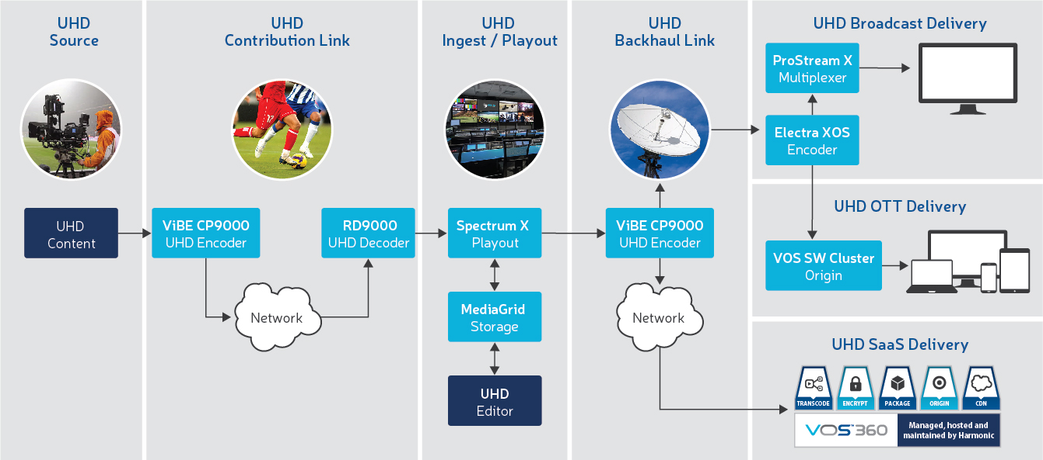
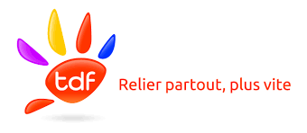


Harmonic Solutions
Notes:
Let’s have a look at the UHD total addressable market for Harmonic. With no surprise, the end-to-end UHD solution starts with the shooting of the live UHD content, its contribution from the sport venue for instance to the studio where the content is ingested, edited, branded and playout and then its final delivery to the main TV screen. For all those processing steps, we have products and solutions to offer.

